Slide 1
Sensitivity Analysis of Radiation Distribution in W7X
P. Hacker¹, F. Reimold¹, R. Burhenn¹, D. Zhang¹
¹Max Planck Institute for Plasmaphysics, Wendelsteinstraße 1, 17491 Greifswald, DE

Slide 2
Background & Motivation
Plasma radiation
Data acquisition & calibrations
Plasma feedback
Fast valve of thermal helium beam
We try to use the Bolometer to control the plasma based off of information on the radiation distribution.
adjust heat loads, investigate radiation regimes, improved detachment
investigate radiation (scaling), i.e. importance of intrinsic/extrinsic impurities

Slide 3
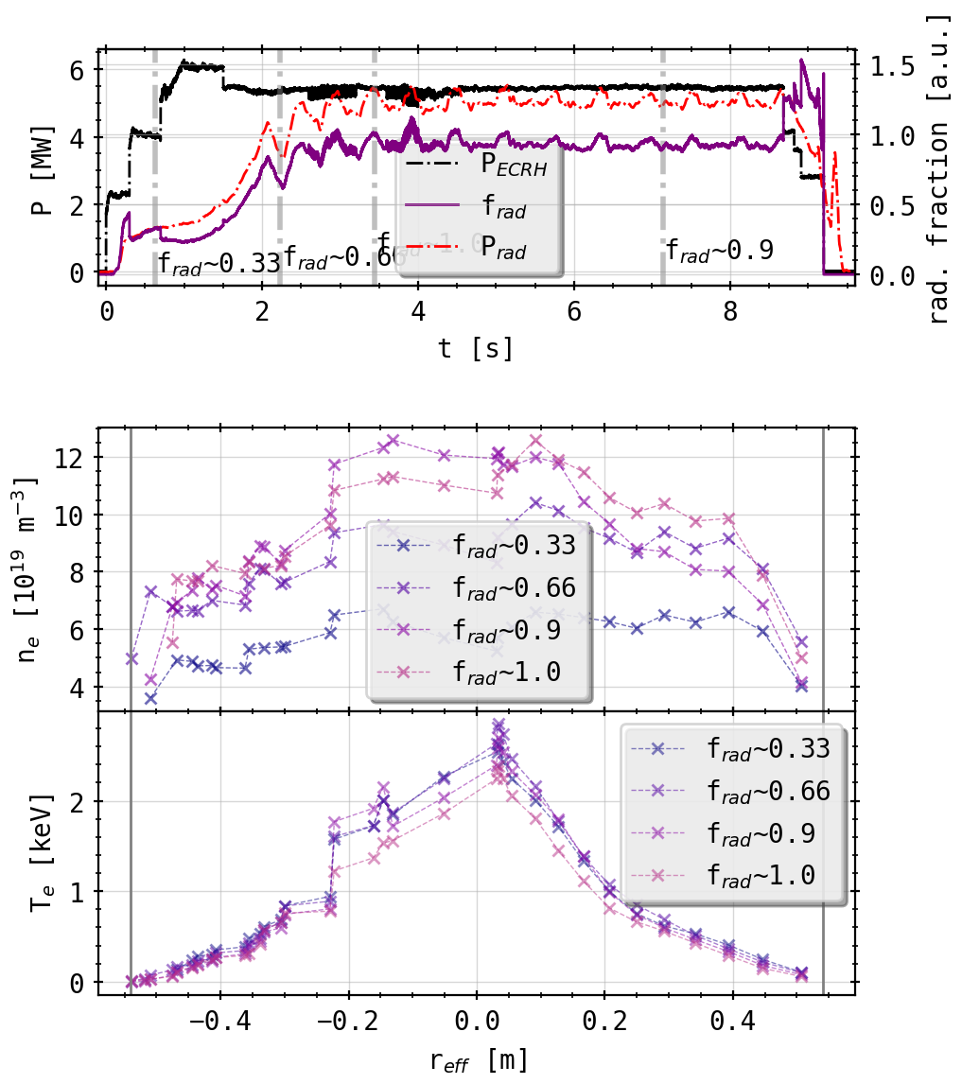
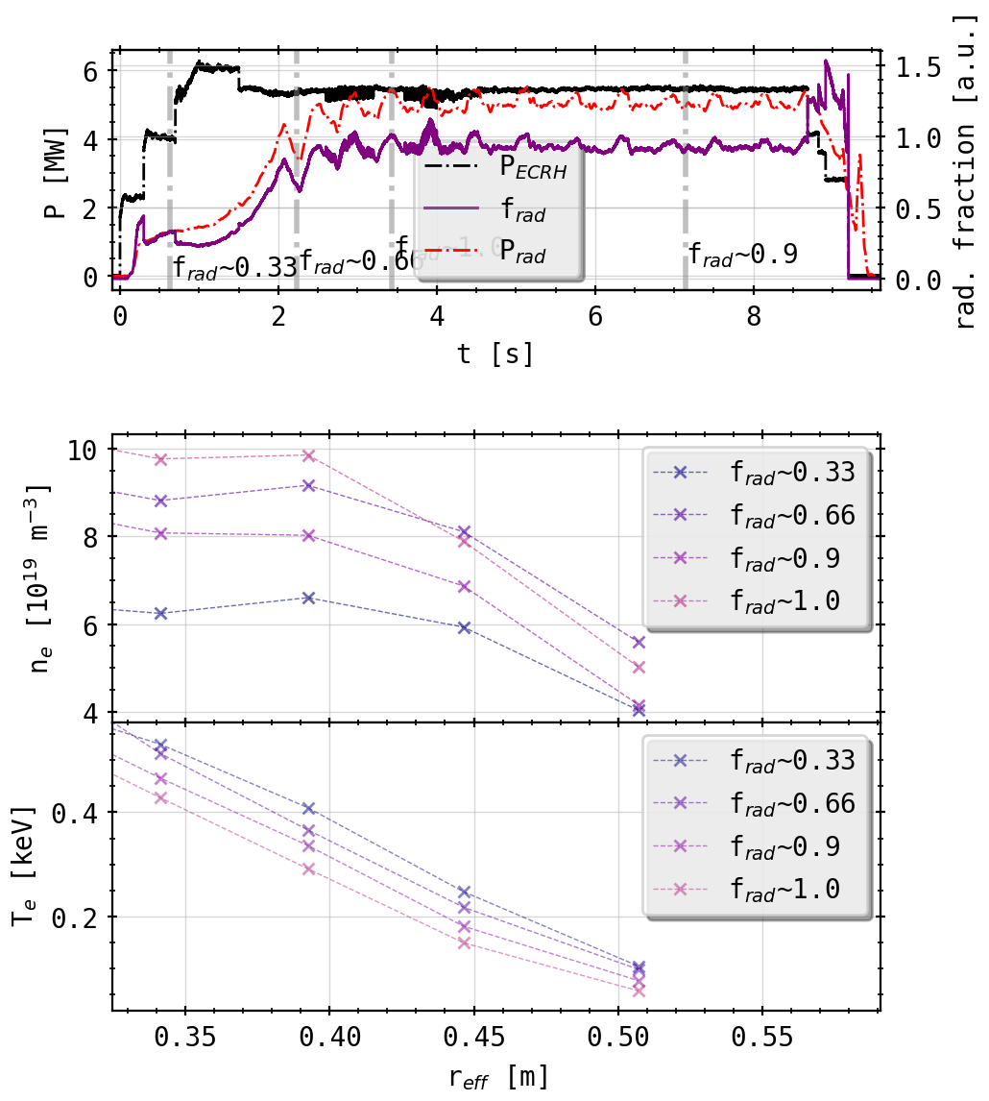
Background & Motivation
electron temperature decreases with greater radiation fraction and increasing density
plasma irradiates more energy, lowering the temperature while maintaining/increasing the density

Slide 4
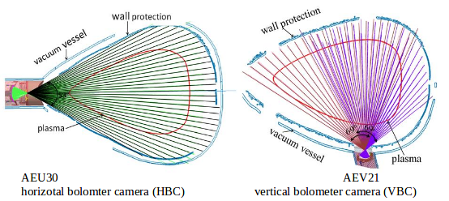
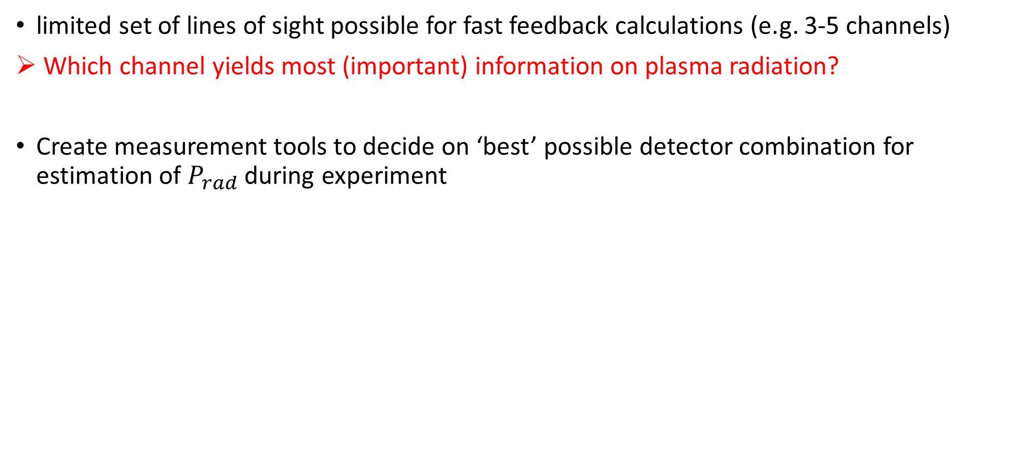
Feedback Evaluation
limited set of lines of sight possible for fast feedback calculations (e.g. 3-5 channels)
Which channel yields most (important) information on plasma radiation?
Create measurement tools to decide on ‘best’ possible detector combination for estimation of $P_{rad}$ during experiment
HBCm

Slide 5
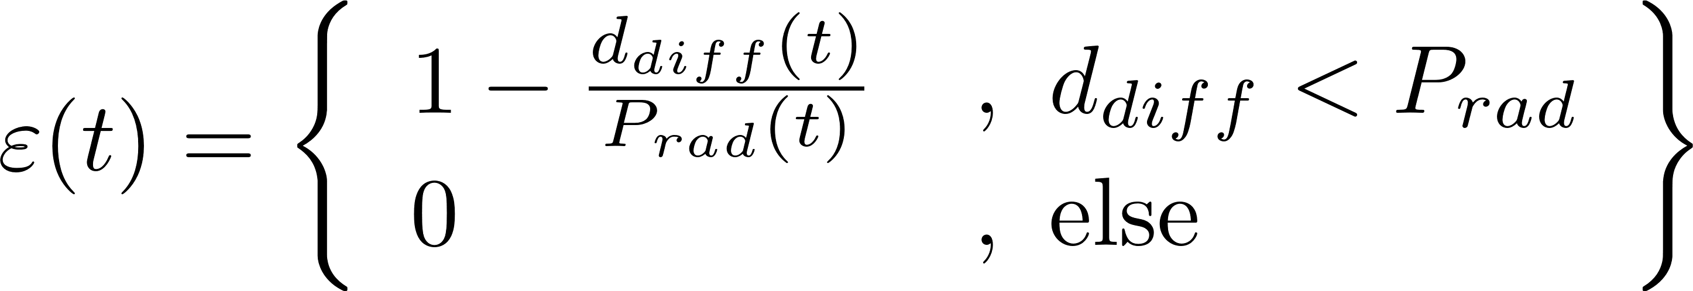
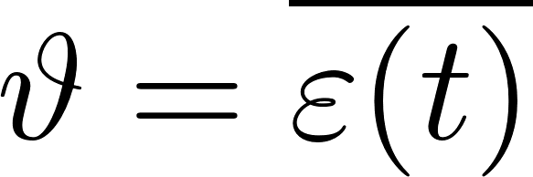
Feedback Evaluation
Example:
done for >10⁴ combinations of cameras and channels
+ 8 different sensitivity metrics (e.g. self correlation, coherence, convolutional)
+ multiple experiments

Slide 6
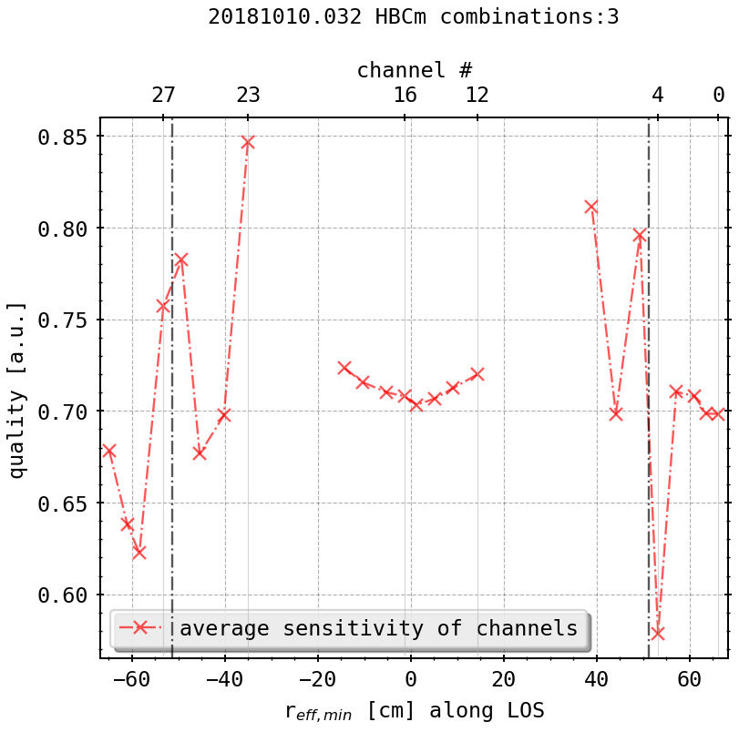
Feedback Evaluation
all evaluation methods and camera/subset combinations show same behavior:
detectors viewing tangential to LCFS are capable of representing >60% of the plasma radiation
LOS along LCFS & slightly inwards are most sensitive to changes in the plasma radiation
a subset of 5 detectors can reflect the total radiation with up to 90% accuracy (!)
LCFS

Slide 7
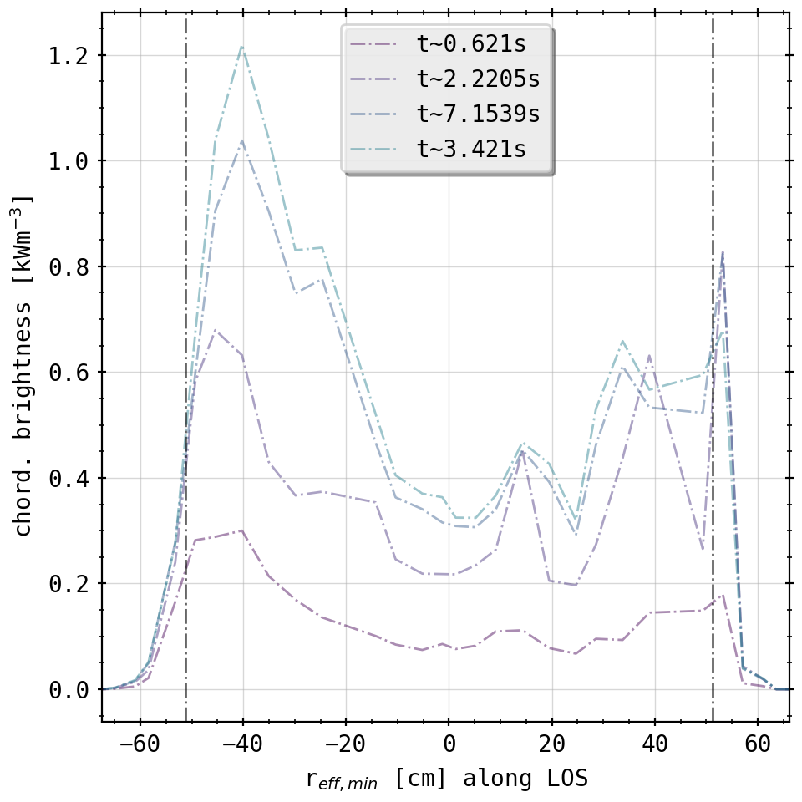
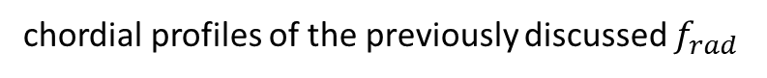
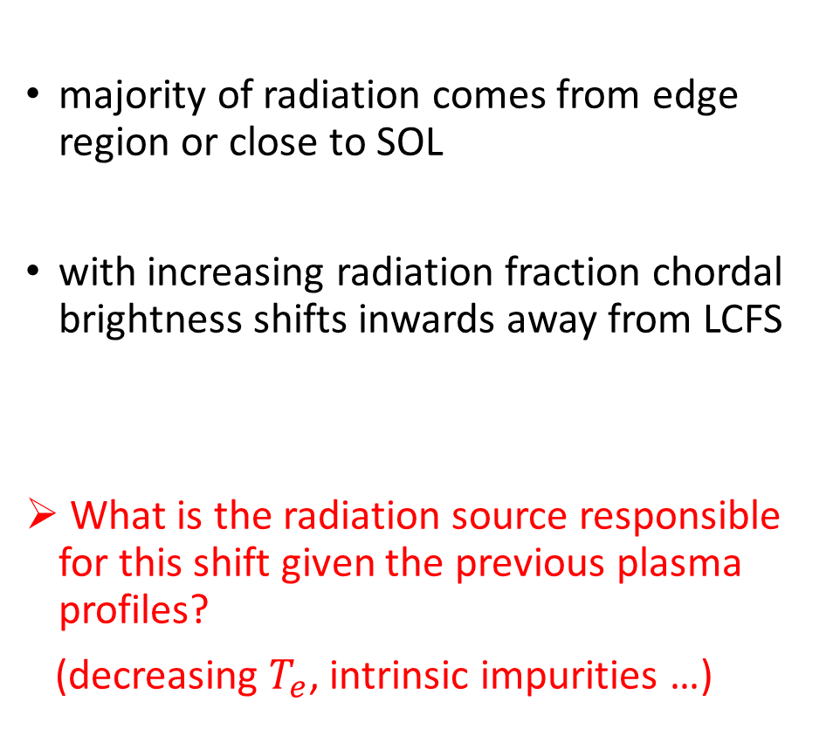
Feedback Evaluation
majority of radiation comes from edge region or close to SOL
with increasing radiation fraction chordal brightness shifts inwards away from LCFS
What is the radiation source responsible for this shift given the previous plasma profiles?
(decreasing $T_{e}$, intrinsic impurities …)
100%
90%
66%
33%
chordial profiles of the previously discussed $f_{rad}$

Slide 8
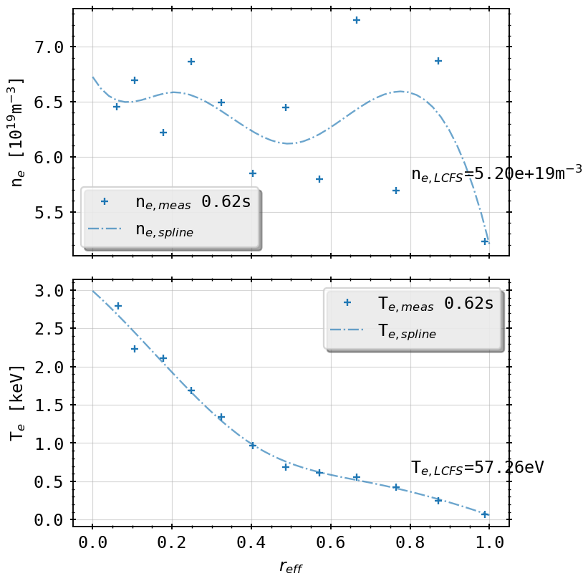
STRAHL Simulations of Carbon Radiation
assuming 1D radiation distribution given the chordal profiles, i.e. coming from inside the LCFS
investigating main intrinsic impurity carbon (i.e. lines measured also by HEXOS)
Thomson Scattering profiles from radiation feedback controlled plasma
TS profiles (+) and STRAHL profiles for $f_{rad}=0.33$

Slide 9
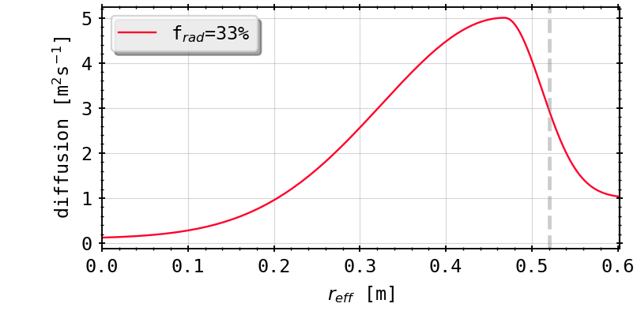
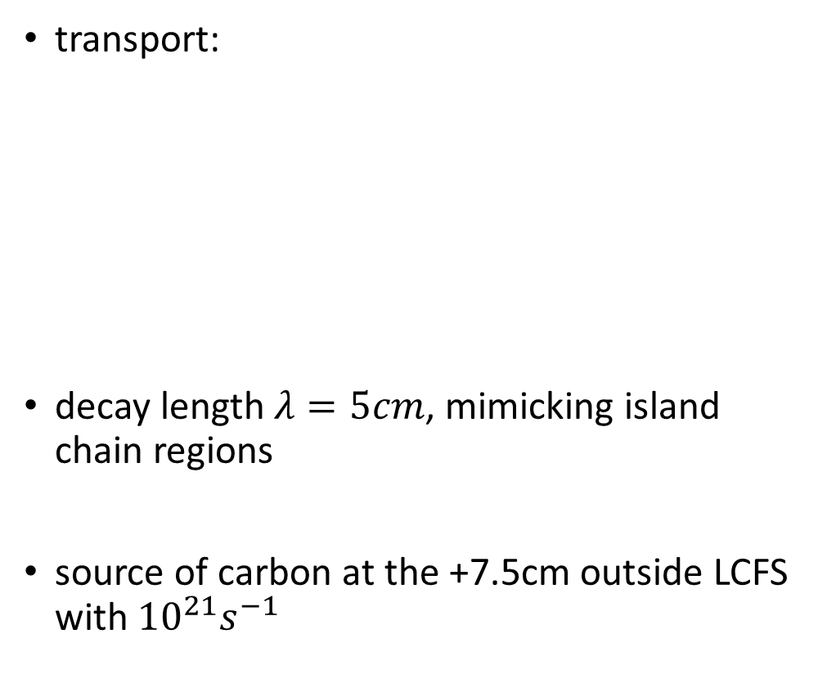
STRAHL Simulations of Carbon Radiation
transport:
decay length $λ=5cm$, mimicking island chain regions
source of carbon at the +7.5cm outside LCFS with${ 10}^{21}s^{−1}$
TS profiles (+) and STRAHL profiles for $f_{rad}=0.33$

Slide 10
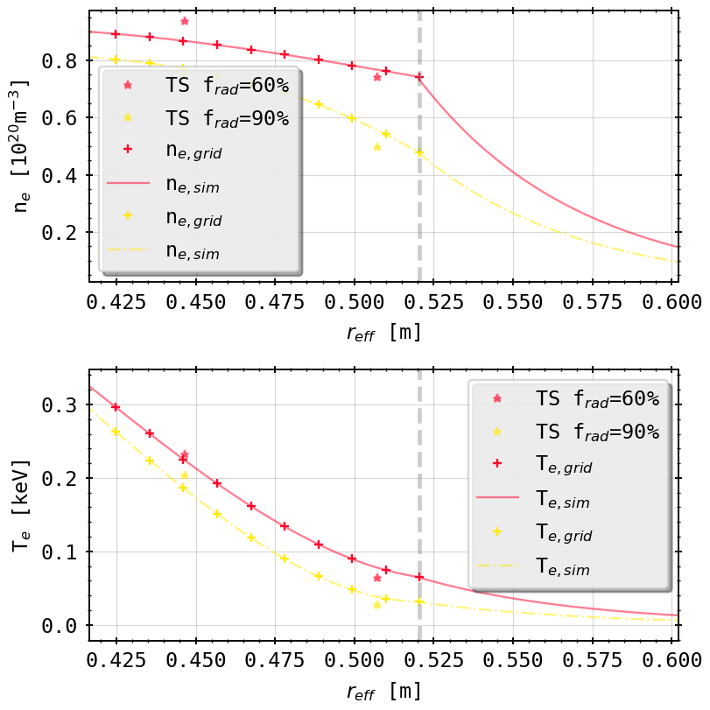
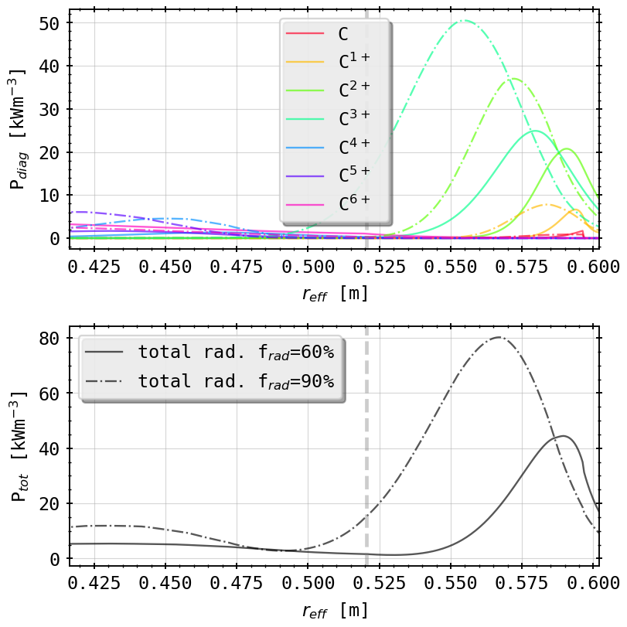
STRAHL Simulations: 60% v 90%
57eV
31eV
TS profiles (*) and STRAHL profiles for $f_{rad}=0.6, 0.$9
coronal equilib. line radiation profiles for $f_{rad}=0.6, 0.9$

Slide 11
STRAHL Simulations: 60% v 90%
inward shift of all stages
inconclusive for Bolometer: spatial resolution 5cm on-axis inside LCFS
radiation peak outside LCFS
coronal equilib. line radiation profiles for $f_{rad}=0.6, 0.9$

Slide 12
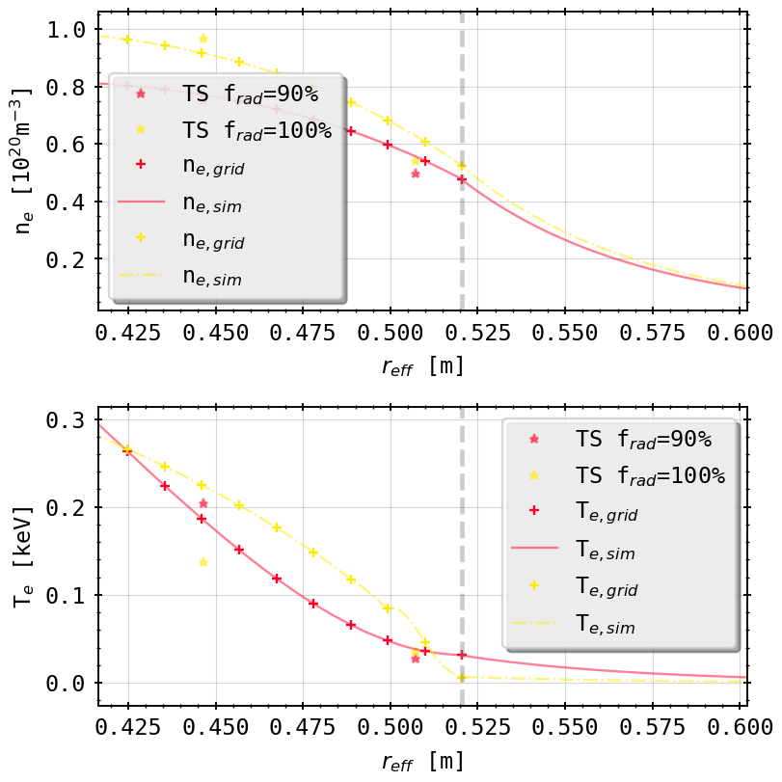
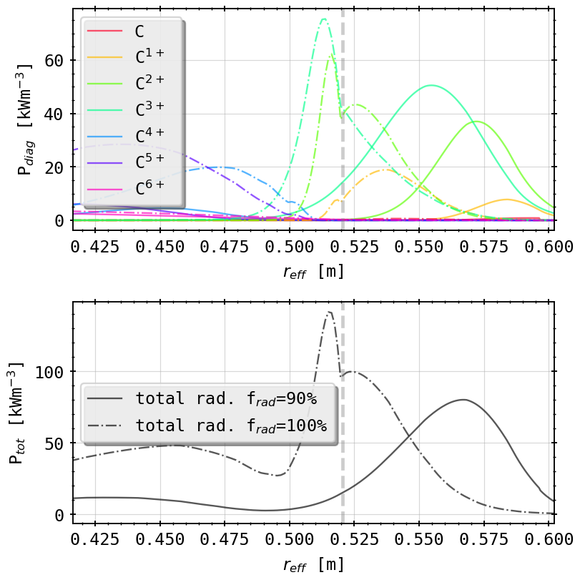
STRAHL Simulations: 90% v 100%
31eV
6eV
TS profiles (+) and STRAHL profiles for $f_{rad}=0.9, 1.0$
coronal equilib. line radiation profiles for $f_{rad}=0.9, 1.0$

Slide 13
STRAHL Simulations: 90% v 100%
peak impurity radiation now inside the confined region > core radiating carbon population
volume integrated radiation around experimental level
coronal equilib. line radiation profiles for $f_{rad}=0.9, 1.0$

Slide 14
STRAHL Simulations: 90% v 100%
great radial shift, especially now in Be- and Li-like ions
transition from bright to dark SOL from 90% to 100% of radiation power loss
possible indicator for radiation regimes in detachment
intrinsic impurity C main radiation source for those scenarios
coronal equilib. line radiation profiles for $f_{rad}=0.9, 1.0$

Slide 15
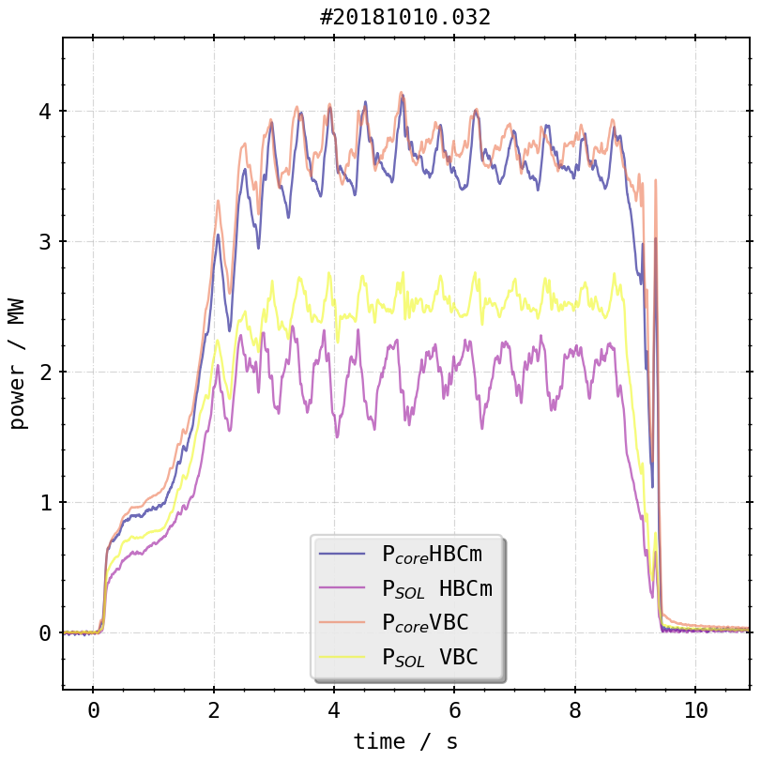
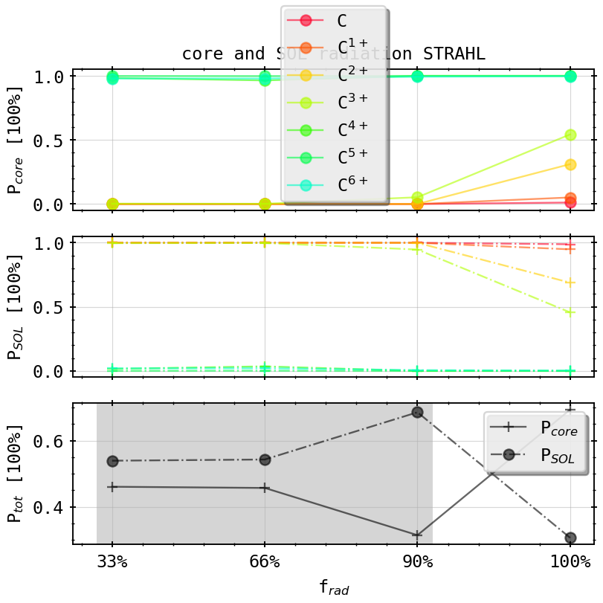
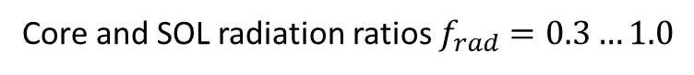
STRAHL Simulations: Core vs. SOL Radiation
anticyclical changes in experiments core/SOL radiation
absolute ratio different due to LOS geometry
Core and SOL radiation ratios $f_{rad}=0.3…1.0$

Slide 16
STRAHL Simulations: Core vs. SOL Radiation
reminder:
anticyclical changes in experiments core/SOL radiation
absolute ratio different because LOS geometry

Slide 17
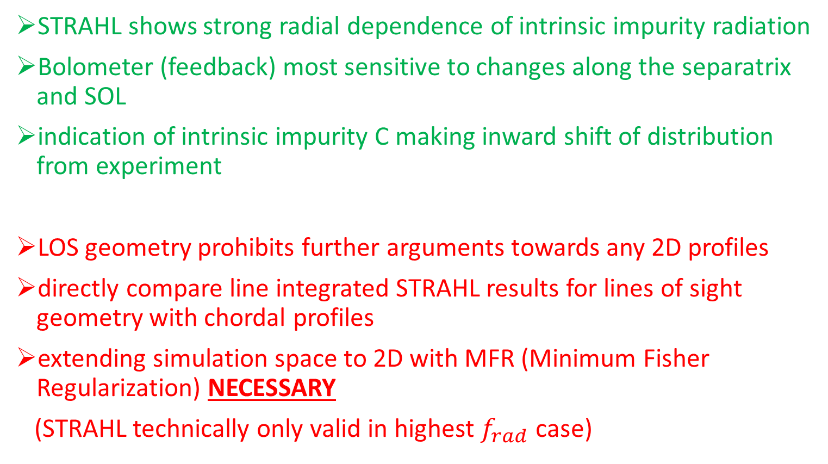
Summary & Outlook
STRAHL shows strong radial dependence of intrinsic impurity radiation
Bolometer (feedback) most sensitive to changes along the separatrix and SOL
indication of intrinsic impurity C making inward shift of distribution from experiment
LOS geometry prohibits further arguments towards any 2D profiles
directly compare line integrated STRAHL results for lines of sight geometry with chordal profiles
extending simulation space to 2D with MFR (Minimum Fisher Regularization) NECESSARY
(STRAHL technically only valid in highest $f_{rad}$ case)

Slide 18
Appendix

Slide 19
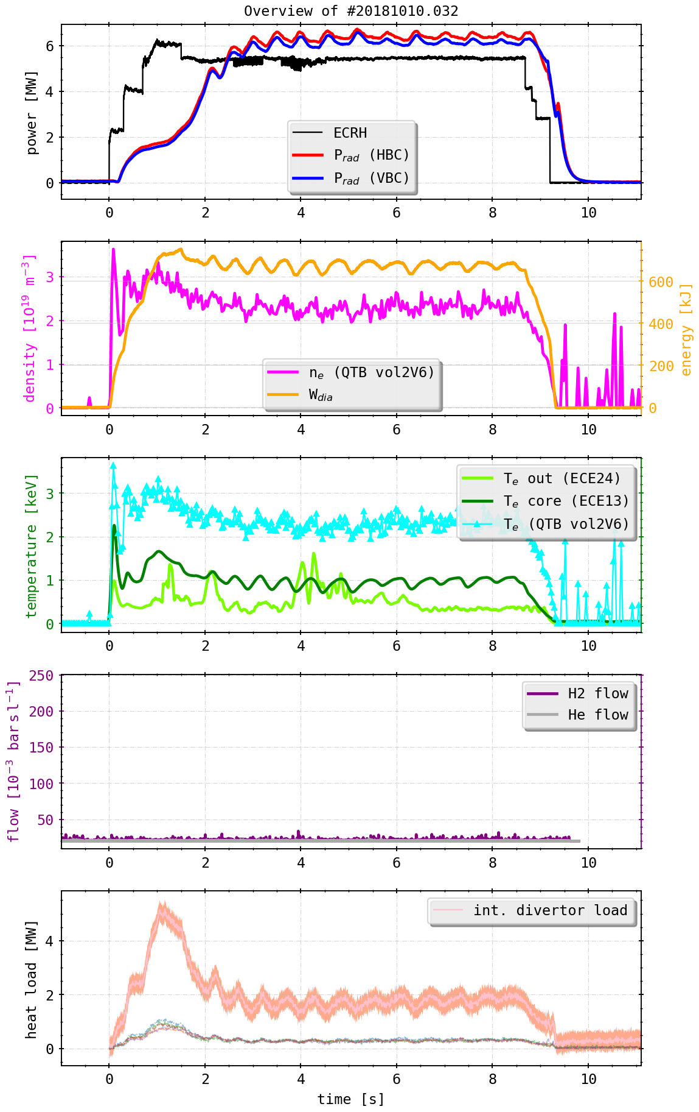
Background & Motivation
Plasma radiation
Data acquisition & calibrations
Plasma feedback
Fast valve of thermal helium beam

Slide 20
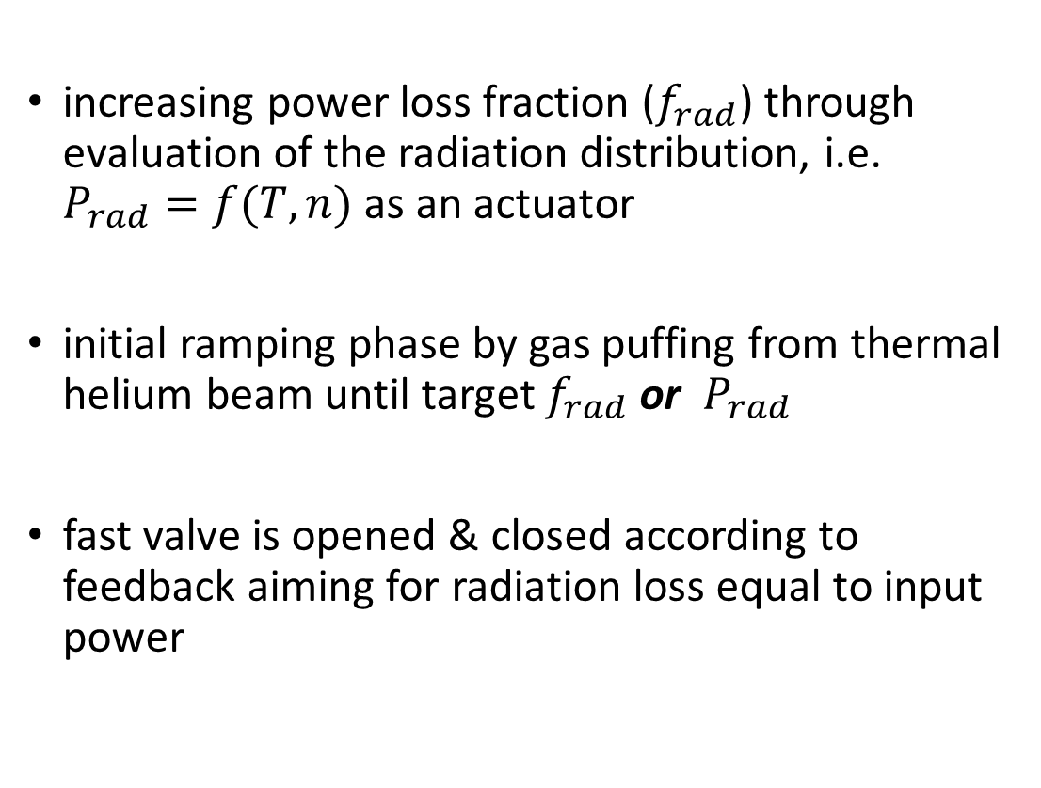
Background & Motivation
increasing power loss fraction ($f_{rad}$) through evaluation of the radiation distribution, i.e. $P_{rad}=f(T,n)$ as an actuator
initial ramping phase by gas puffing from thermal helium beam until target $f_{rad}$ or $P_{rad}$
fast valve is opened & closed according to feedback aiming for radiation loss equal to input power

Slide 21
Background & Motivation
electron temperature decreases with greater radiation fraction and increasing density
plasma irradiates more energy, lowering the temperature while maintaining/increasing the density
LCFS

Slide 22
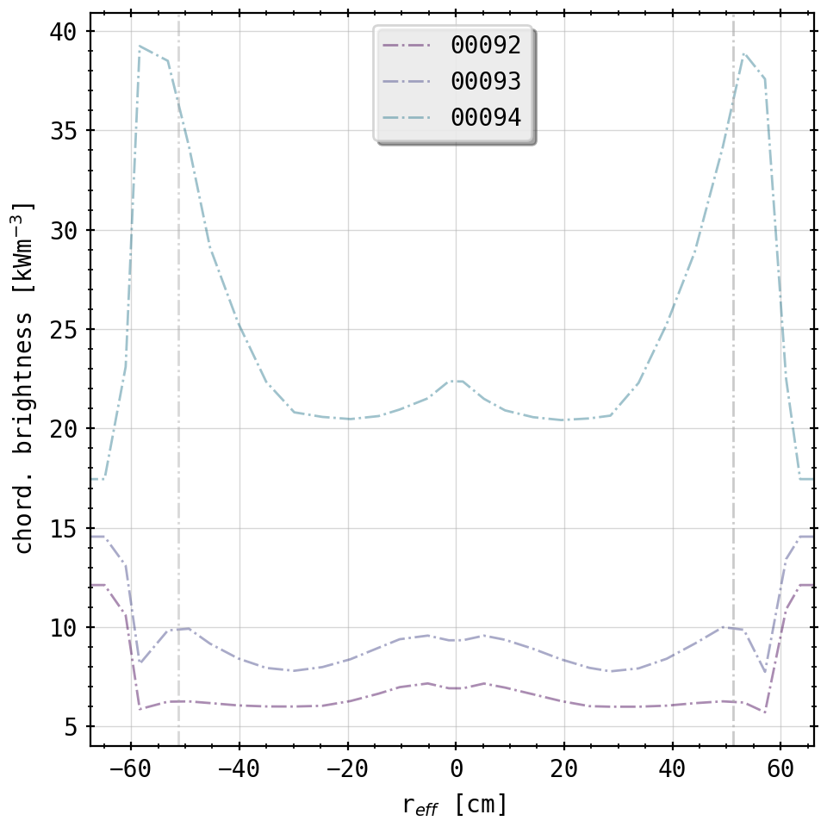
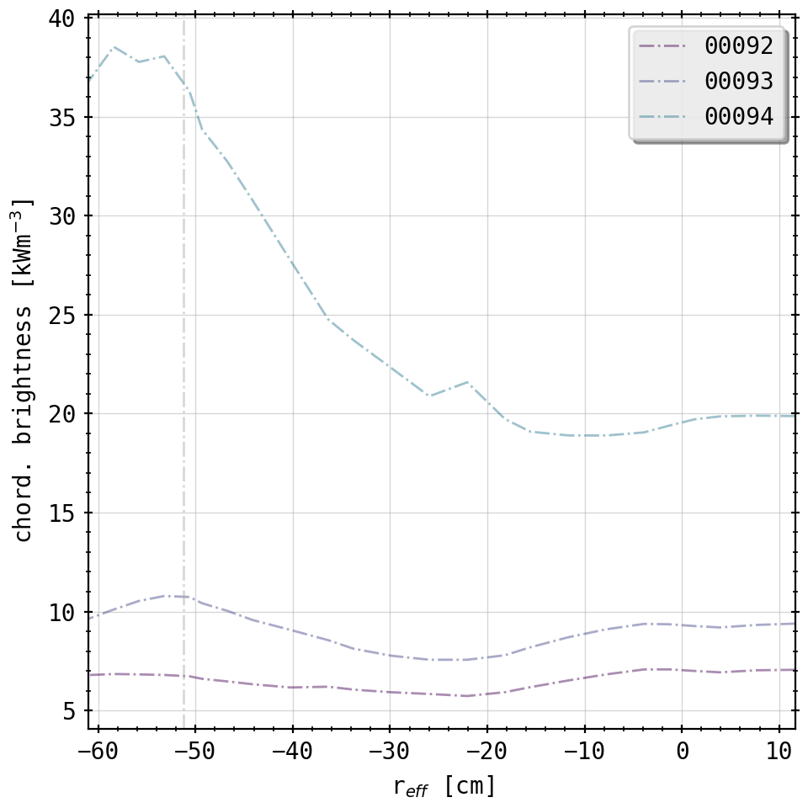
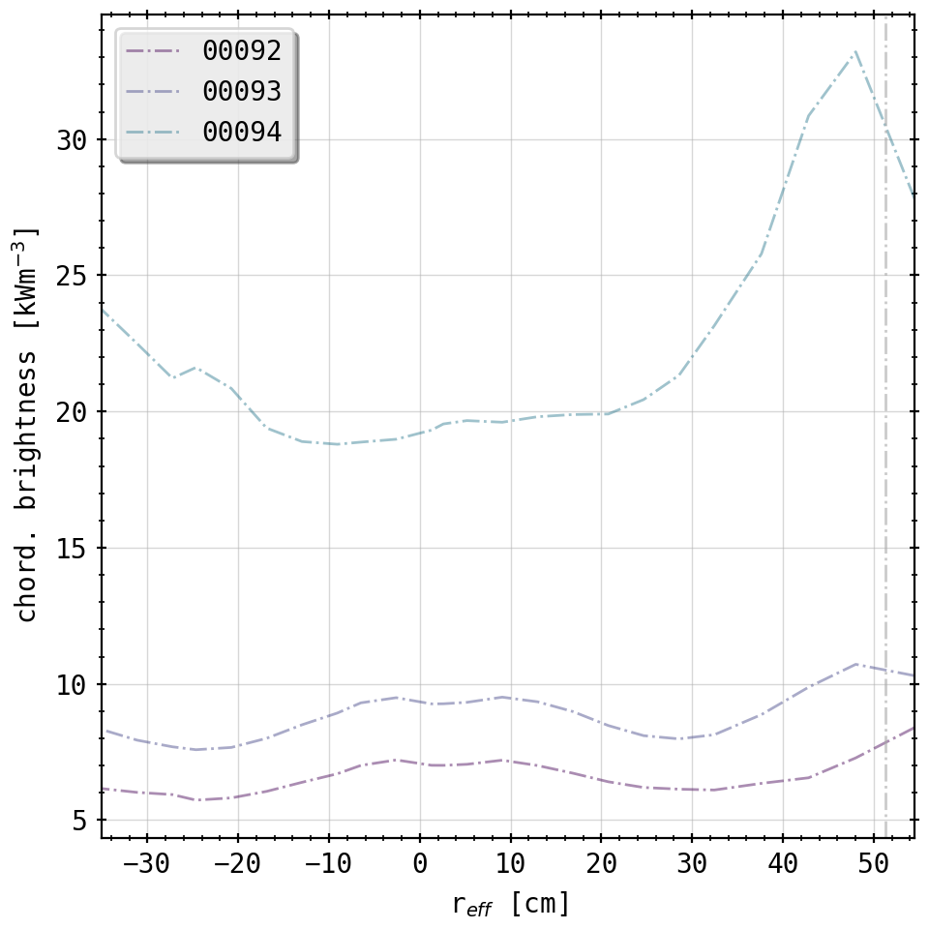
Appendix: Forward Integration with LOS
HBCm
VBCl
VBCr
LCFS
LCFS
LCFS
100%
100%
100%
90%
90%
90%
60%
60%
60%

Slide 23
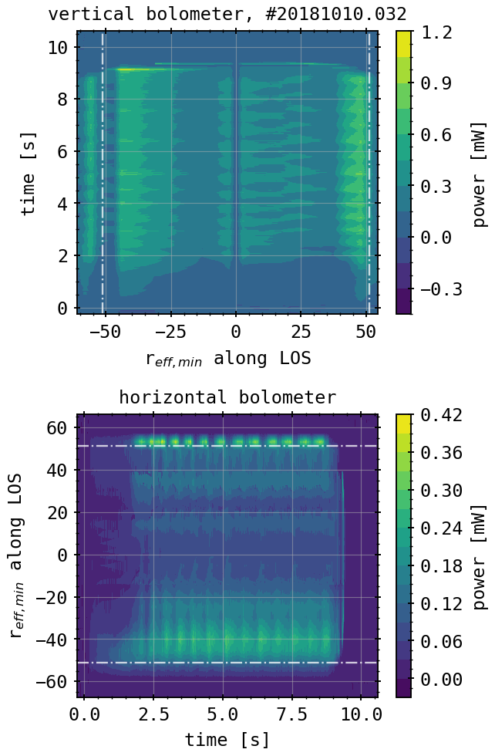
Appendix: Chordal Profiles
LCFS
LCFS

Slide 24
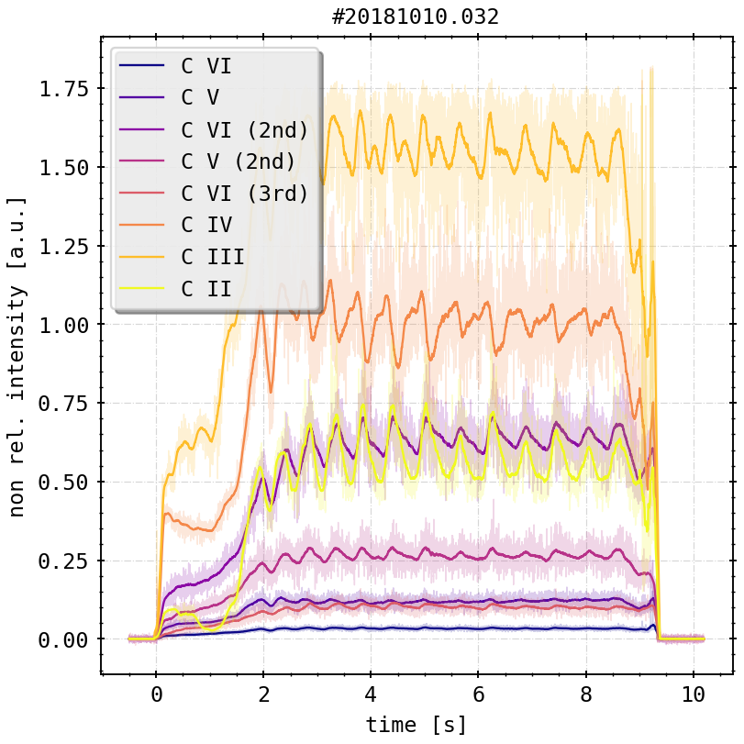
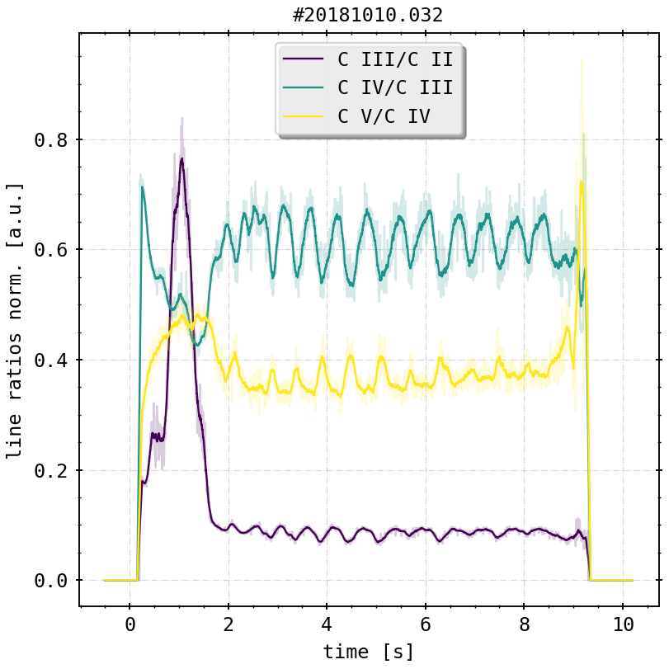
Appendix: HEXOS Lines

Slide 25
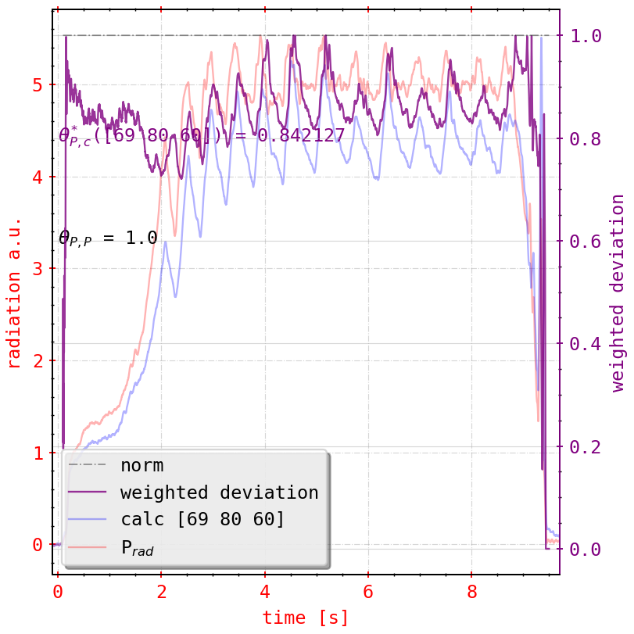
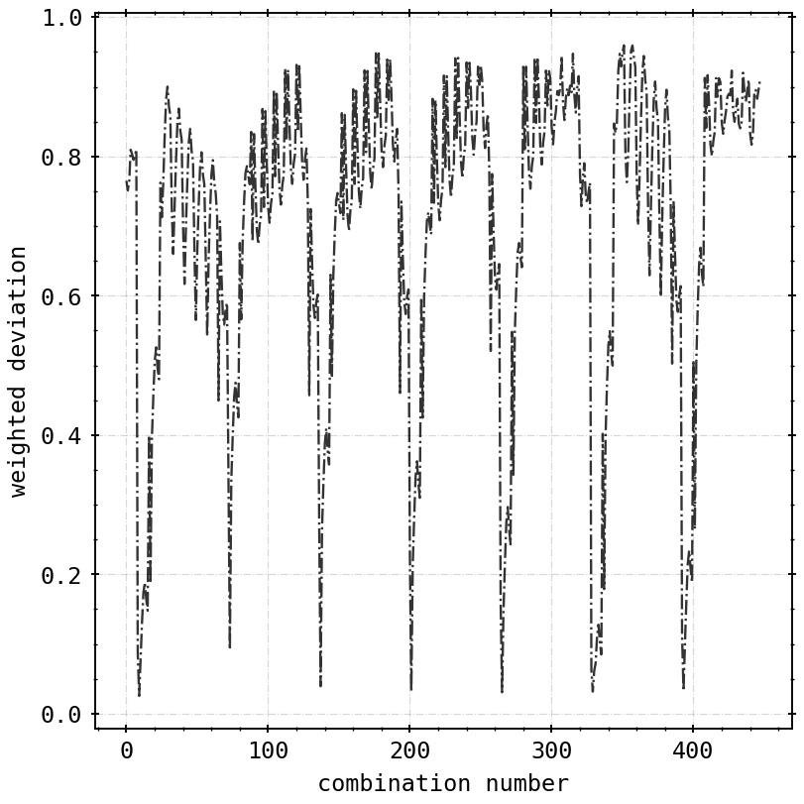
Appendix: Sensitivity Analysis

Slide 26
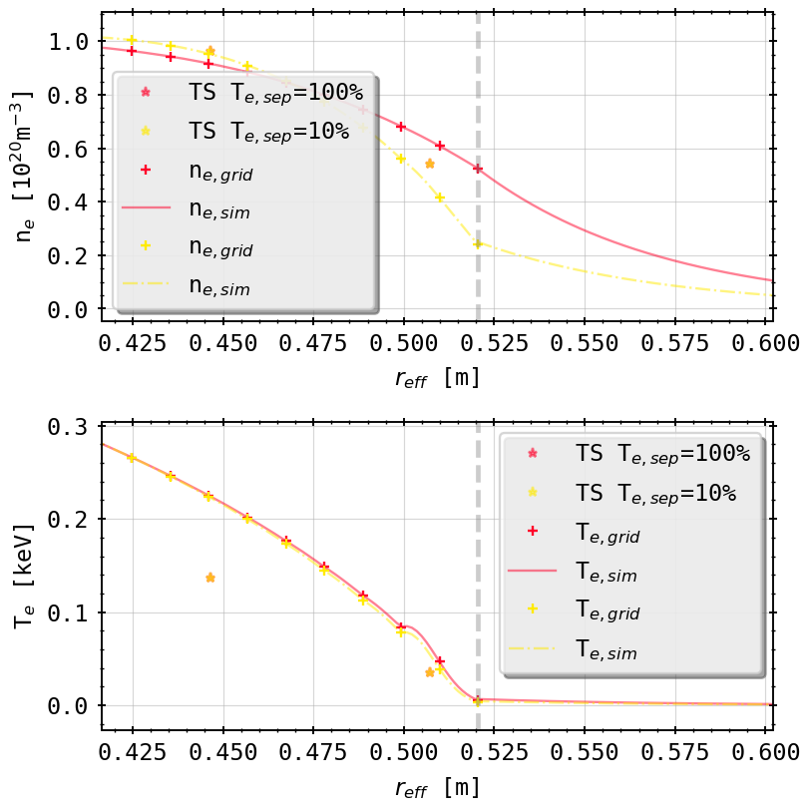
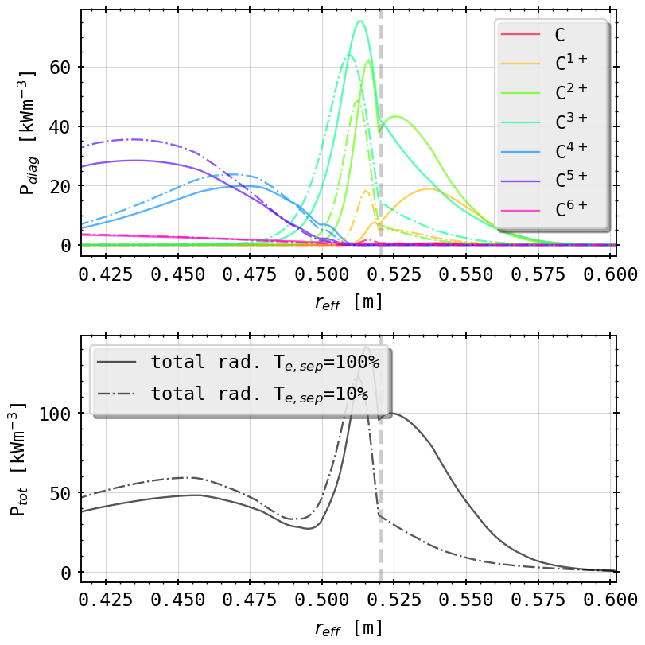
Appendix: 100% - 100% v 10% LCFS n/T
5.5eV
3eV
TS profiles last point scaled down, spline fit for continuity

Slide 27
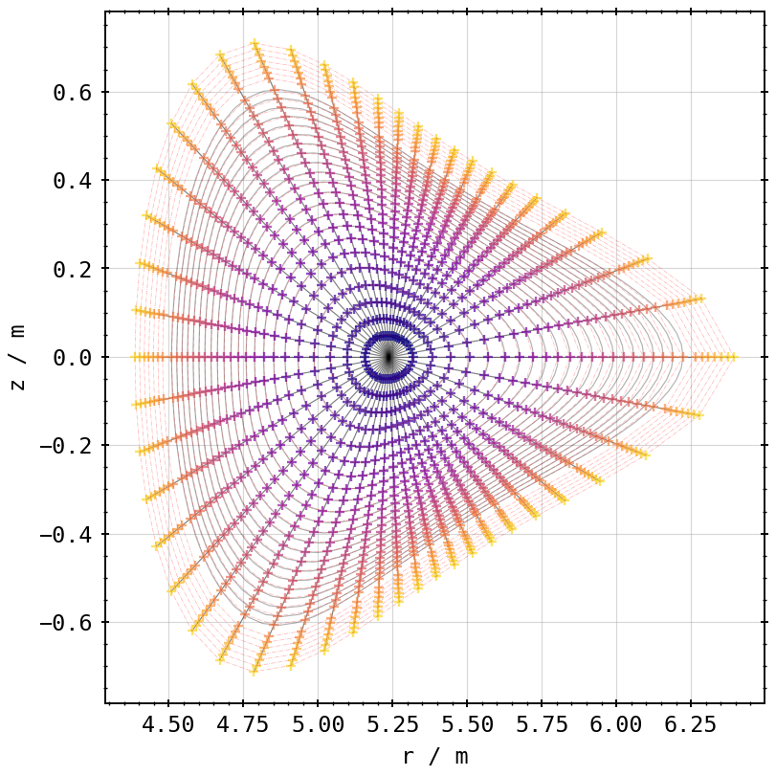
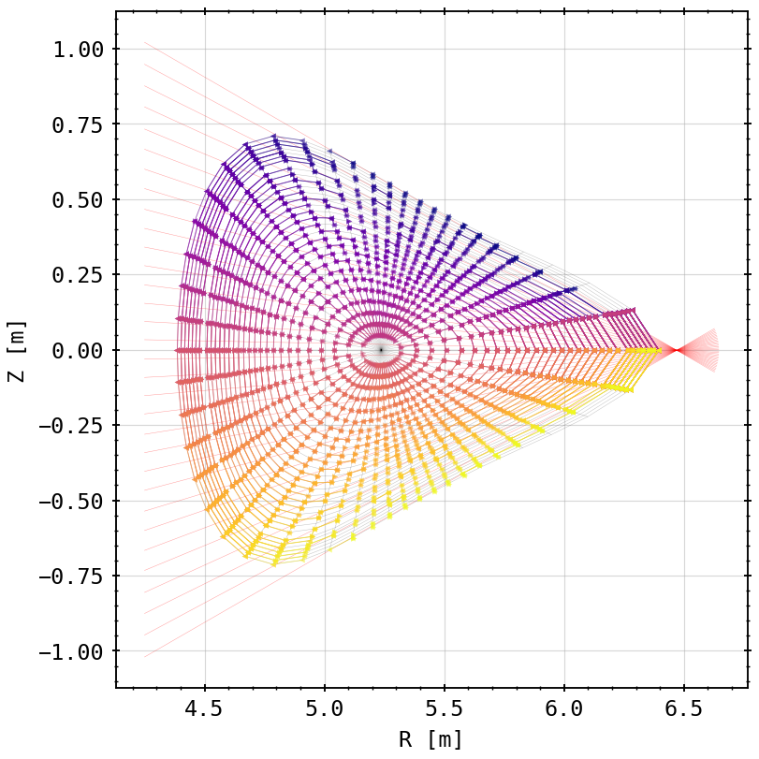
Appendix: Emissivity Factors
mesh from EIM VMEC equilibrium flusxurfaces with extended shells
line of sight cuts through mesh cells (HBCm)

Slide 28
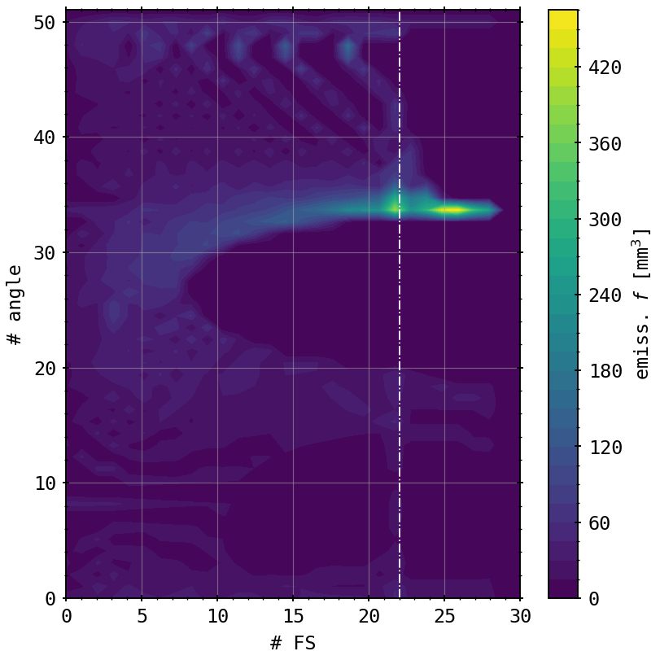
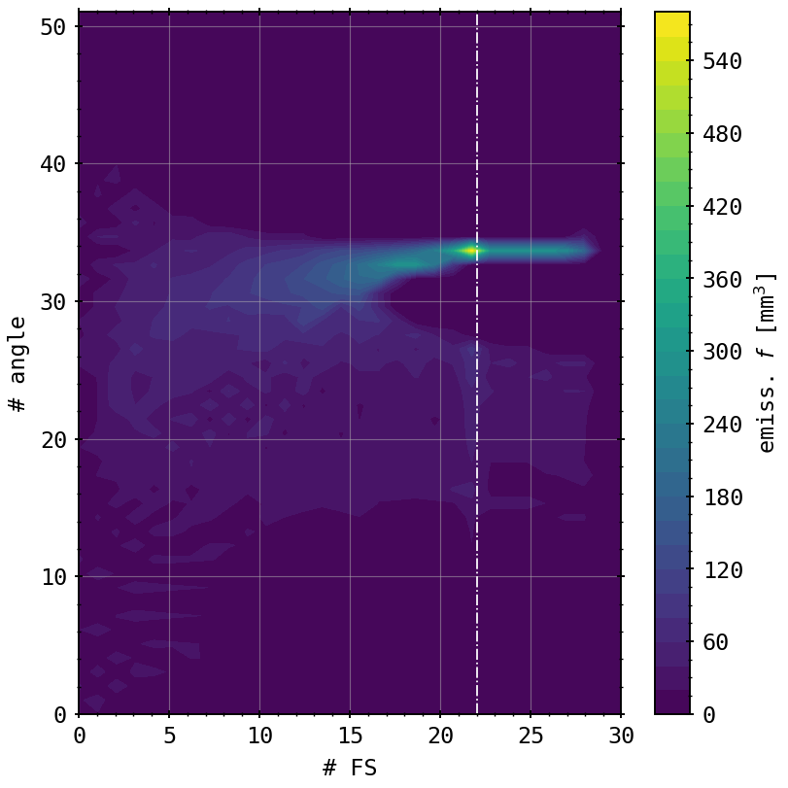
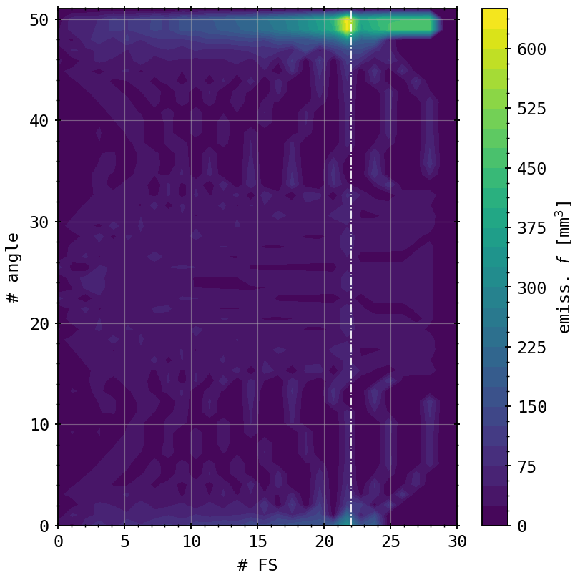
Appendix: Emissivity Factors
VBCr
VBCl
HBCm

